Slide 1
Môn: Tiếng Anh
Tiết:63
Tuần dạy: 16
Tên bài dạy: Unit 10: Our summer holidays. Lesson 1 (4,5,6)
Ngày dạy: 24 / 12 / 2024.
Notes:
MADE BY FACEBOOK :TRAN THI THANH TAM

Slide 2
Nguyen Binh Khiem Primary School
WELCOME TO
OUR CLASS 4
Teacher: Nguyễn Thị Bích Vi
Made by
Thanh Tam
Notes:
MADE BY FACEBOOK :TRAN THI THANH TAM

Slide 3
UNIT 10:OUR SUMMER HOLIDAYS
LESSON 1 ( 4, 5, 6 )
Notes:
MADE BY FACEBOOK :TRAN THI THANH TAM

Slide 4
CONTENTS
1
WARM -UP
2
LISTEN AND TICK
3
LOOK, COMPLETE AND READ
4
LET’S SING
5
SING A SONG
Notes:
MADE BY FACEBOOK :TRAN THI THANH TAM

Slide 5
Warm - up
Notes:
Made by Facebook: TRAN THI THANH TAM

Slide 6
LET’S PLAY
Slap the board

Slide 7
WHAT AND WHERE
At the campsite
At the zoo
In the countryside
On the beach

Slide 8
Notes:
MADE BY FACEBOOK :TRAN THI THANH TAM

Slide 9
the campsite
at the zoo
the countryside
Were
Yes
Notes:
MADE BY FACEBOOK :TRAN THI THANH TAM

Slide 10
Notes:
MADE BY FACEBOOK :TRAN THI THANH TAM

Slide 11
Let's play
Notes:
MADE BY FACEBOOK :TRAN THI THANH TAM

Slide 12
1
2
THE
FOOTBALL GAME
4
3
NEXT

Slide 13
_____ you at the zoo
last weekend?
Were
A. When
B. Whens
C. Were

Slide 14
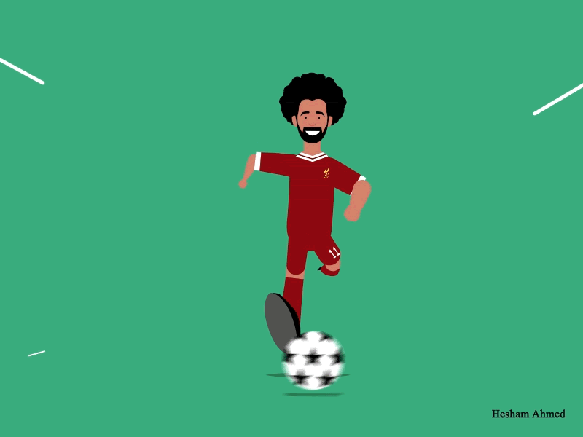
+ 3 points

Slide 15
campsite
Were you at the …………..
last weekend? -> Yes, I was
A. campsite
B. beach
C. zoo

Slide 16
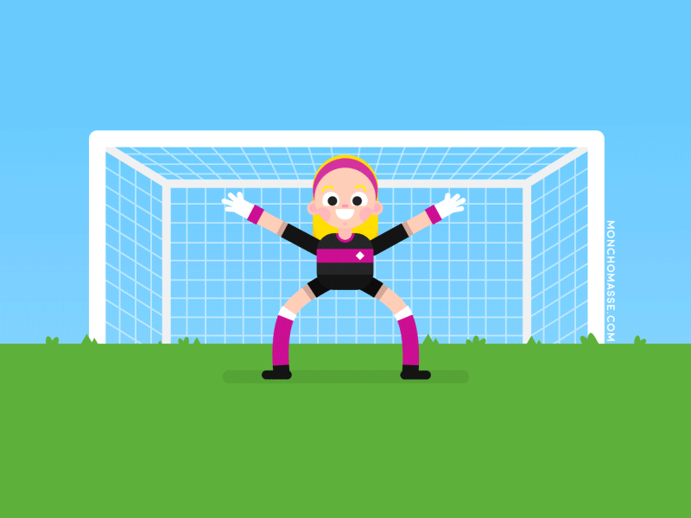
+ 5 points

Slide 17
countryside
Were you in the…………..…………..
last weekend? -> Yes, I was
A. campsite
B. beach
C. countryside

Slide 18
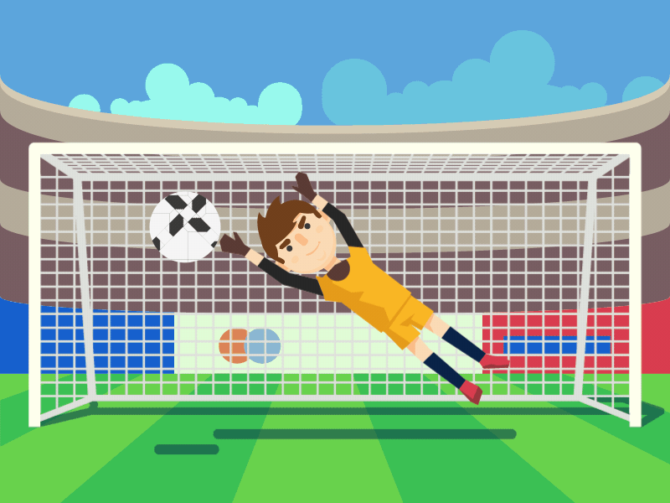
+ 2 points

Slide 19
beach
Were you on the ………….
last weekend? -> Yes, I was
A. campsite
B. beach
C. countryside

Slide 20
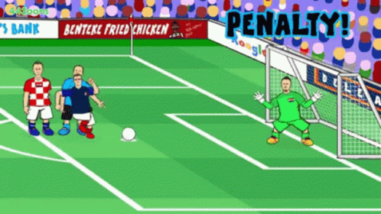
Oh no!
-3 points

Slide 21
Homework:
- Practise more at home
- Prepare Unit 10- lesson 2 ( 1, 2, 3 )

Slide 22
Thank you very much
Good bye! See you again!
Notes:
MADE BY FACEBOOK :TRAN THI THANH TAM

