Slide 1
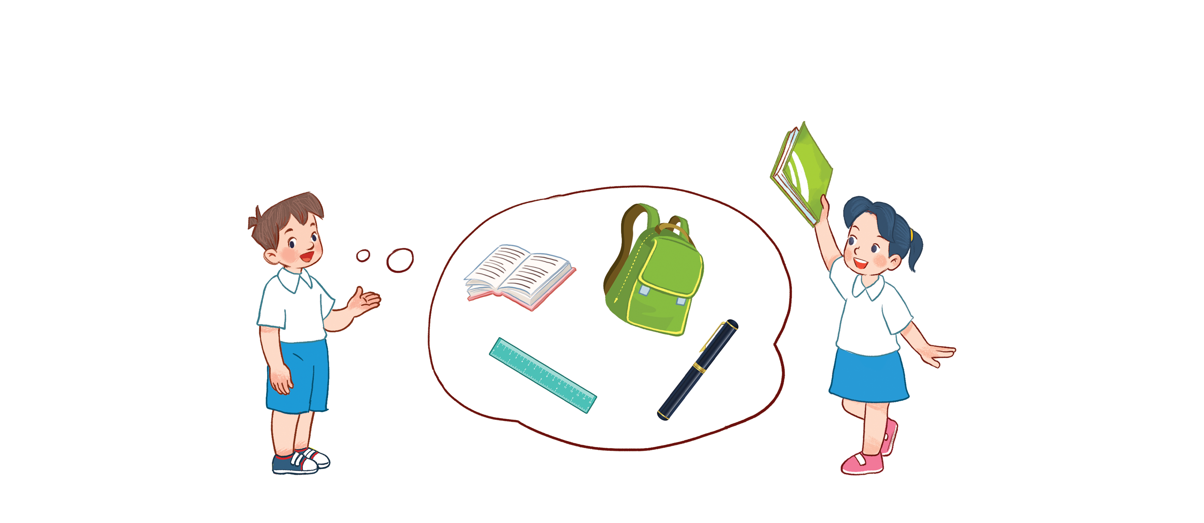
Unit 8
My school things
Lesson 2 - period 2

Slide 2
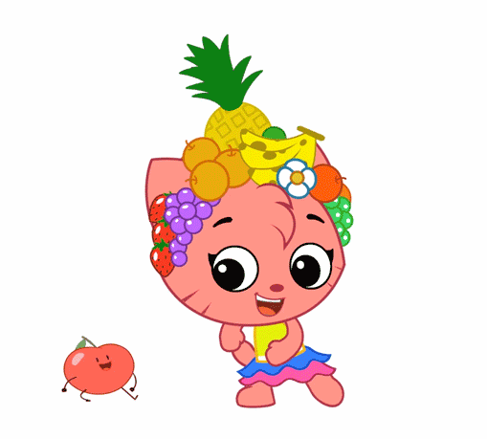
Warm - up
Play

Slide 3
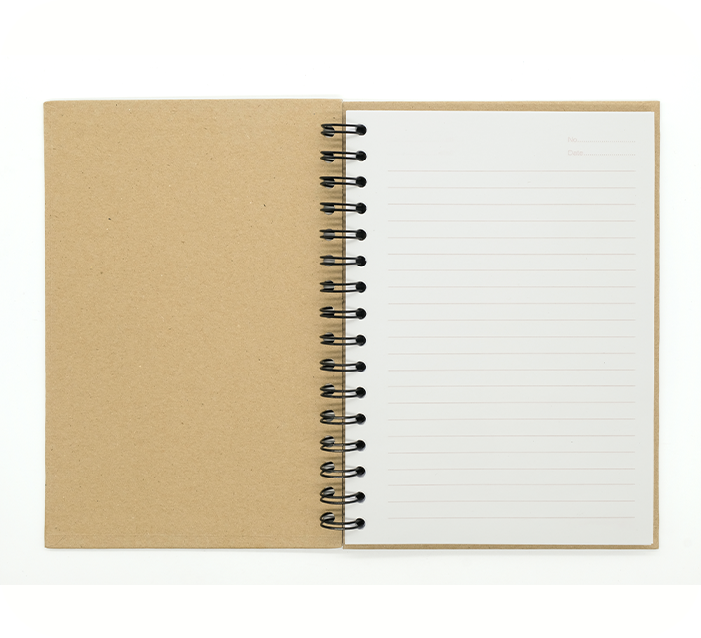
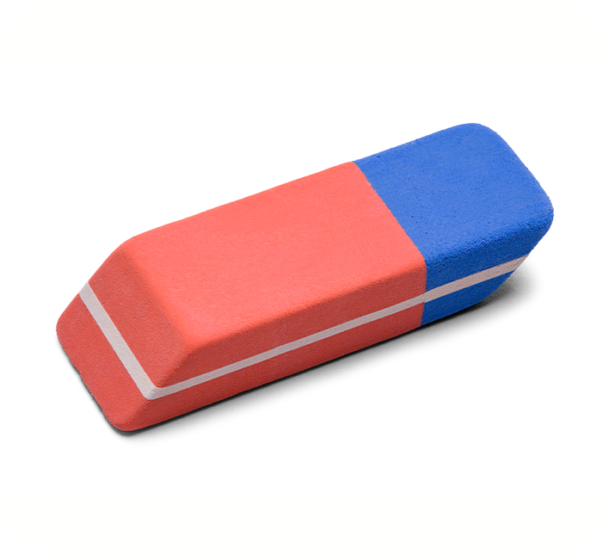
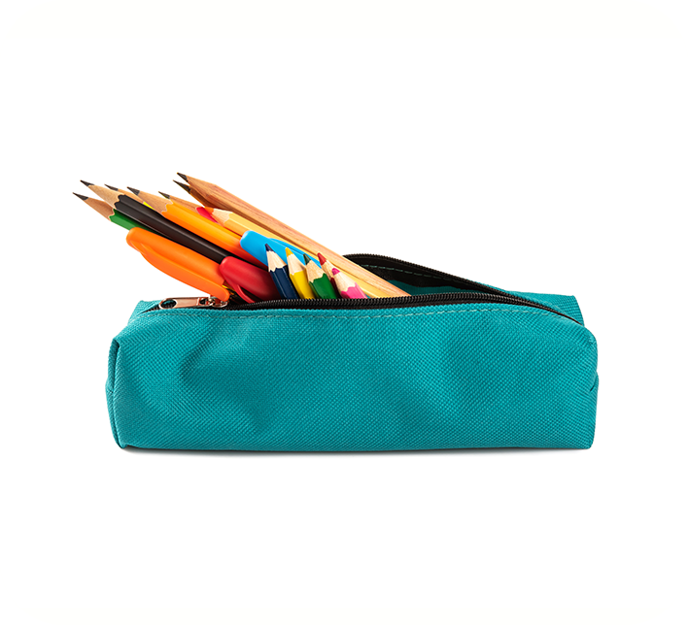
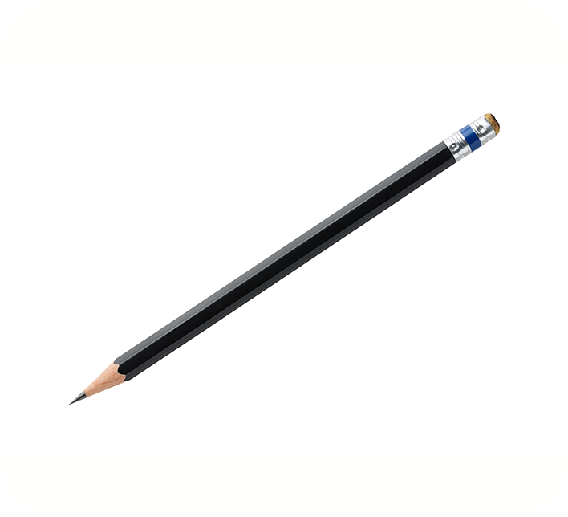
4
Listen and number.
a
3
b
4
a
1
b
2
1
2
3
4

Slide 4
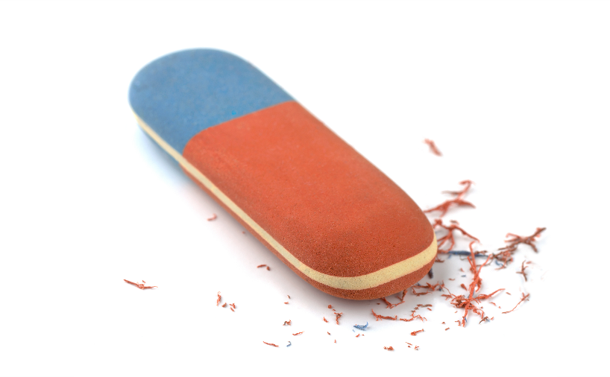
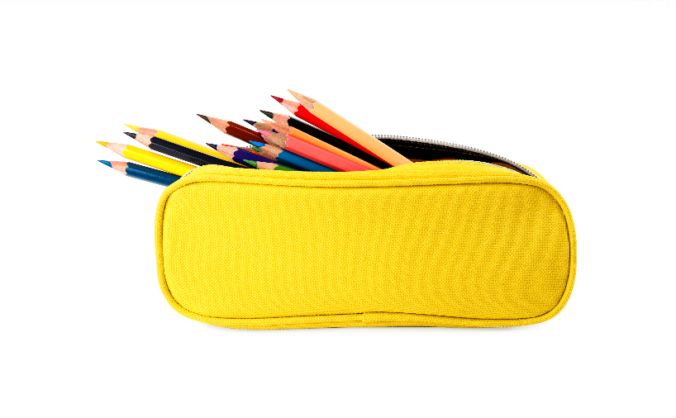
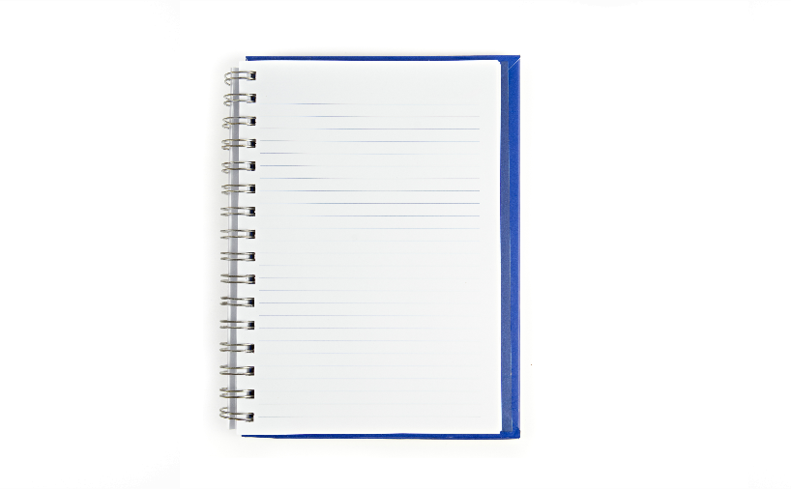
5
Look, complete and read.
a
A: Do you have a notebook? B: Yes, I do.
1
A: Do you have a school bag? B: No, I don’t. I have a pencil case.
b
2
A: Do you have an eraser? B: Yes, I do.
3
c
A: Do you have a pen?
B: No, I don’t. I have a pencil.
4
d

Slide 5
6
Let’s play.

Slide 6
PRERENT WHEEL
10
50
30
30
20
Good job!
40
SPIN/STOP
60
START
60
40
20
30
10
50
Notes:
Ms Huyền Phạm - 0936.082.789

Slide 7
Look and say
Yes, I do.
Do you have a notebook?
Answer
Notes:
Ms Huyền Phạm - 0936.082.789

Slide 8
Look and say
Yes, I do.
Do you have a pencil?
Answer
Notes:
Ms Huyền Phạm - 0936.082.789

Slide 9
Look and say
No, I don’t.
Do you have a pencil case?
Answer
Notes:
Ms Huyền Phạm - 0936.082.789

Slide 10
Look and say
No, I don’t.
Do you have an eraser?
Answer
Notes:
Ms Huyền Phạm - 0936.082.789

Slide 11
Look and say
a notebook
Do you have________?
Yes, I do.
Answer
Notes:
Ms Huyền Phạm - 0936.082.789

Slide 12
Look and say
a pencil case
Do you have________?
Yes, I do.
Answer
Notes:
Ms Huyền Phạm - 0936.082.789 –

Slide 13
Look and say
a pencil
Do you have________?
No, I don’t.
Answer
Notes:
Ms Huyền Phạm - 0936.082.789

Slide 14
Look and say
an eraser
Do you have ________?
No, I don’t.
Answer
Notes:
Ms Huyền Phạm - 0936.082.789 –

Slide 15
Thank you!

