Slide 1
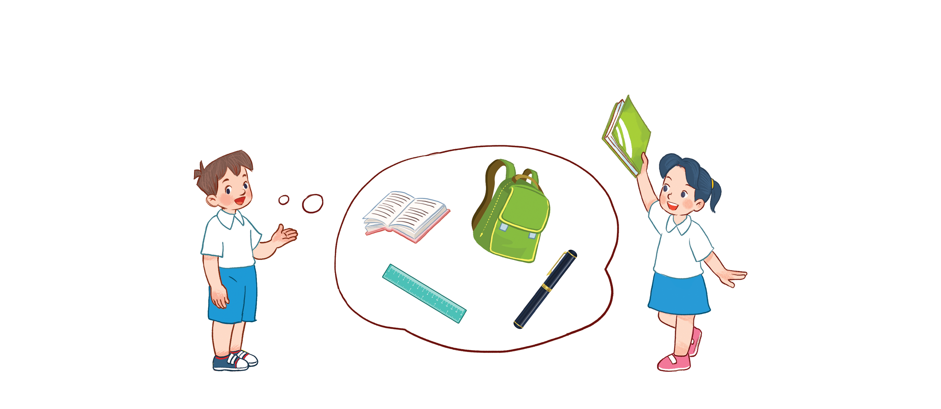
Unit 8
My school things
Lesson 2 - period 1

Slide 2
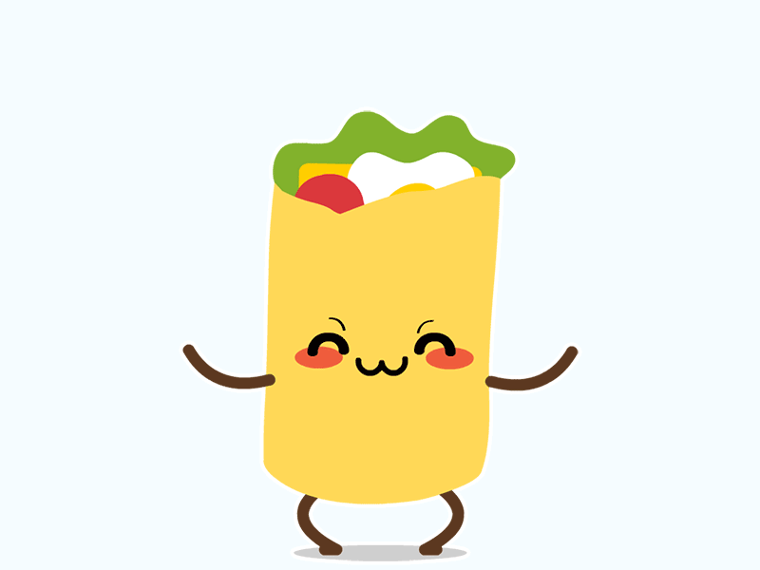
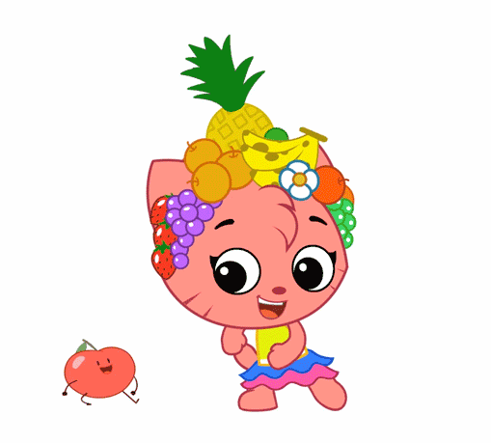
Warm - up
Play

Slide 3
1
Look, listen and repeat.

Slide 4
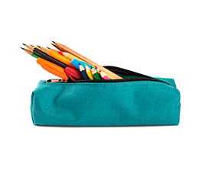
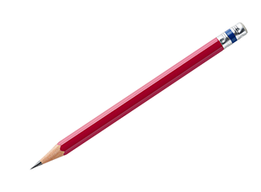
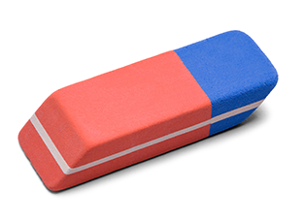
Vocabulary
notebook
/ˈnəʊtbʊk/
: Quyển vở
pencil case
/ˈpensl keɪs/
: Hộp/túi bút
pencil
: Bút chì
/ˈpensl/
eraser
: Cục tẩy/gôm
/ɪˈreɪs/

Slide 5
1
Look, listen and repeat.

Slide 6
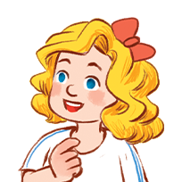
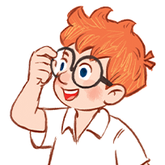
2
Listen, point and say.
Yes, I do.
Do you have _____?
No, I don’t.
a notebook
a pencil case
a pencil
an eraser

Slide 7
Structures
Hỏi và trả lời bạn có cái gì đó không:
Do you have _____?
(Bạn có ____ có phải không?)
Yes, I do.
(Ừ/Vâng, đúng vậy.)
No, I don’t.
(Không, tớ/em không có.)

Slide 8
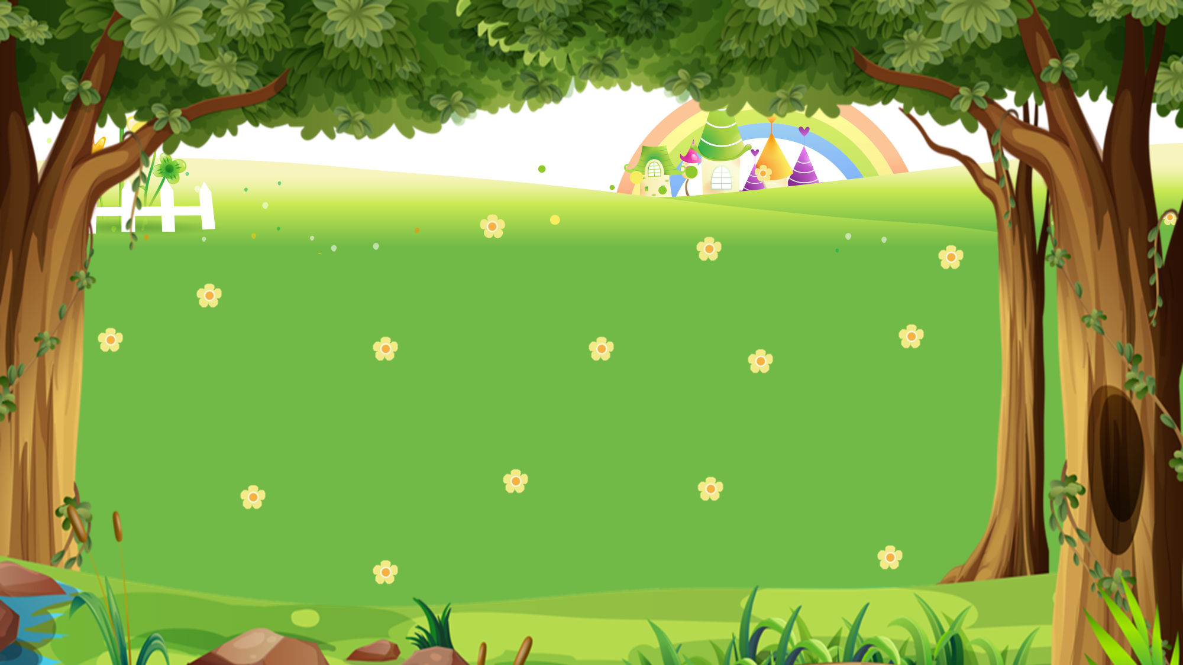
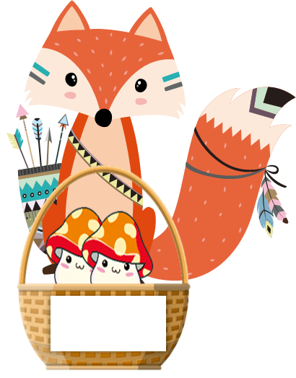
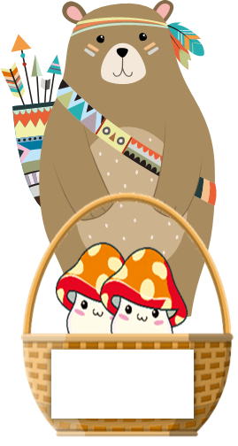
1
2
3
4
5
6
7
8
9
10
1
2
3
4
5
6
7
8
9
1
10
2
3
4
5
6
7
8
9
10

Slide 9
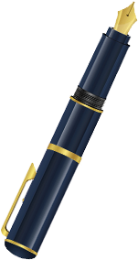
Do you have a pen?
Back
A. Yes, I do.
B. Yes, you do.
C. No, I don’t.

Slide 10
Do you have a _____?
Back
A. ruler
B. pencil.
C. pen

Slide 11
Do you have ______?
Back
A. eraser
B. a eraser
C. an eraser

Slide 12
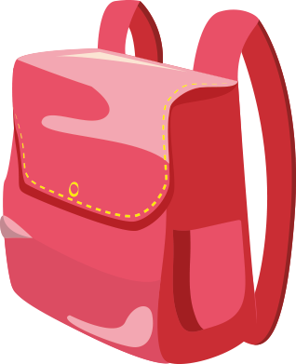
Do you have a school bag?
Back
A. No, I don’t.
B. Yes, I don’t.
C. Yes, I do.

Slide 13
Do you have a ______?
Back
A. a notebook
B. notebook
C. an notebook

Slide 14
Do you have a ruler?
Back
Yes, I do.
B. No, I don’t.
C. No, I don.

Slide 15
Do you have a pen?
Back
A. Yes, I do.
B. No, I do.
C. No, I don’t.

Slide 16
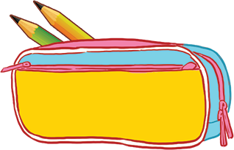
Do you have ________?
Yes, I do.
Back
A. pencil case
B. a pencil case
C. an pencil case

Slide 17
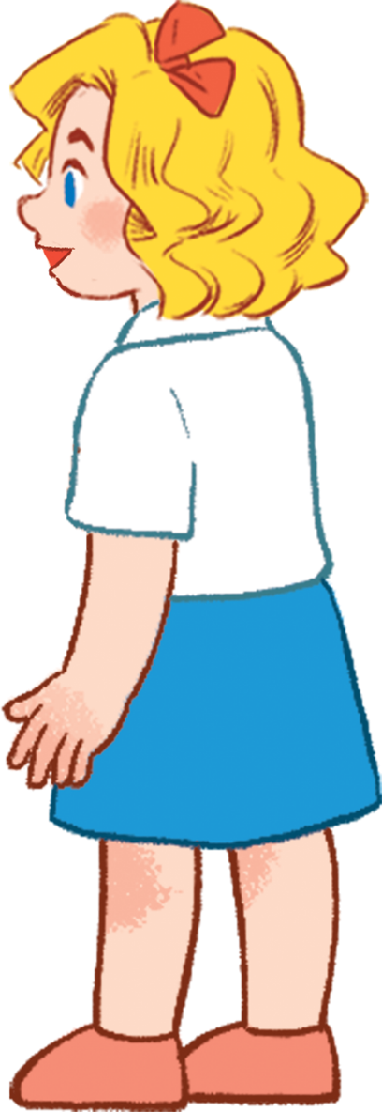
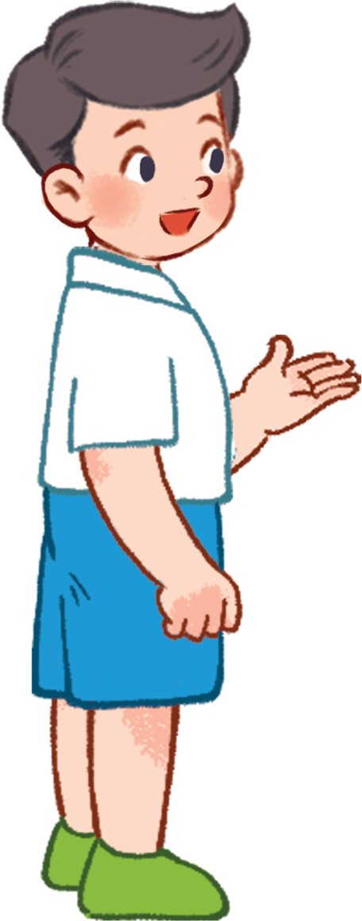
3
Let’s talk.

Slide 18
Thank you!

