Slide 1
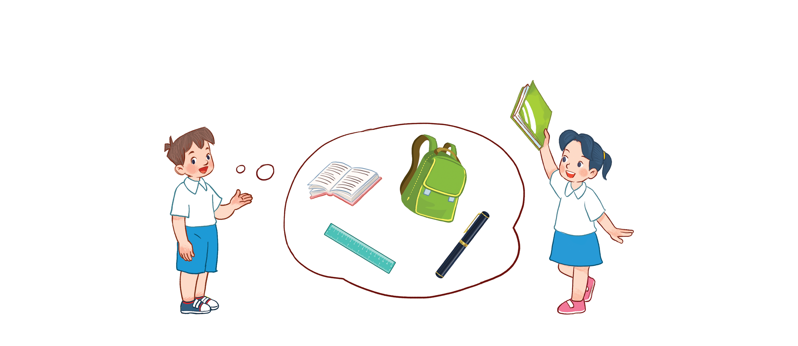
Unit 8
My school things
Lesson 1 - period 1

Slide 2
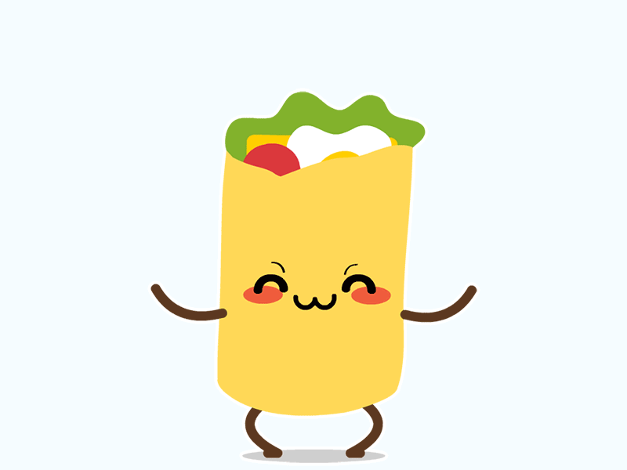
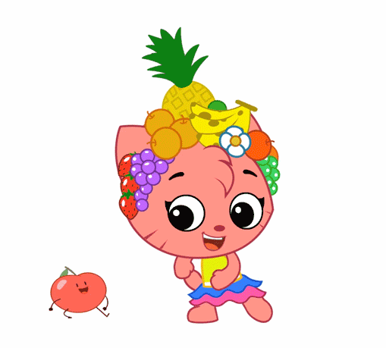
Warm - up
Play

Slide 3
1
Look, listen and repeat.

Slide 4
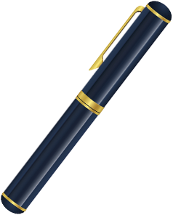
Vocabulary
pen
/pen/
Cái bút

Slide 5
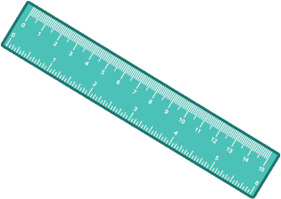
Vocabulary
ruler
/ˈruːlər/
Thước kẻ

Slide 6
Vocabulary
book
/bʊk/
Quyển sách

Slide 7
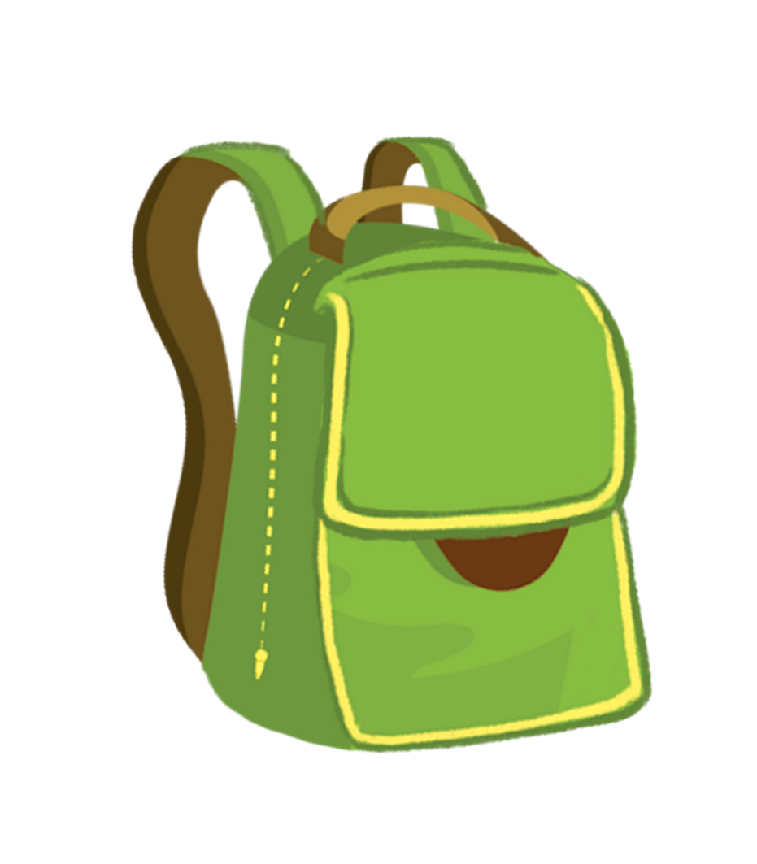
Vocabulary
school bag
/kuːl bæɡ/
Cái cặp

Slide 8
Vocabulary
pen
: Cái bút
/pen/
ruler
: Thước kẻ
/ˈruːlər/
book
: quyển sách
/bʊk/
school bag
: cặp sách
/kuːl bæɡ/

Slide 9
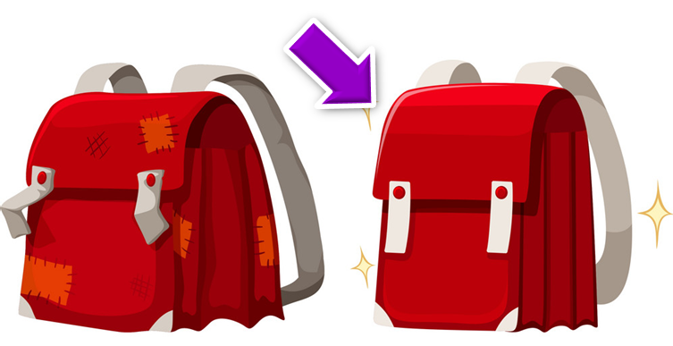
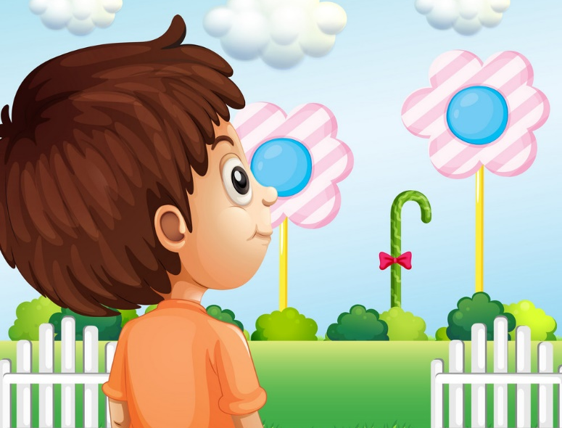
Vocabulary
like
: Thích
/laɪk/
nice
: tốt, đẹp
/naɪs/
look
: nhìn
lʊk/

Slide 10
1
Look, listen and repeat.

Slide 11
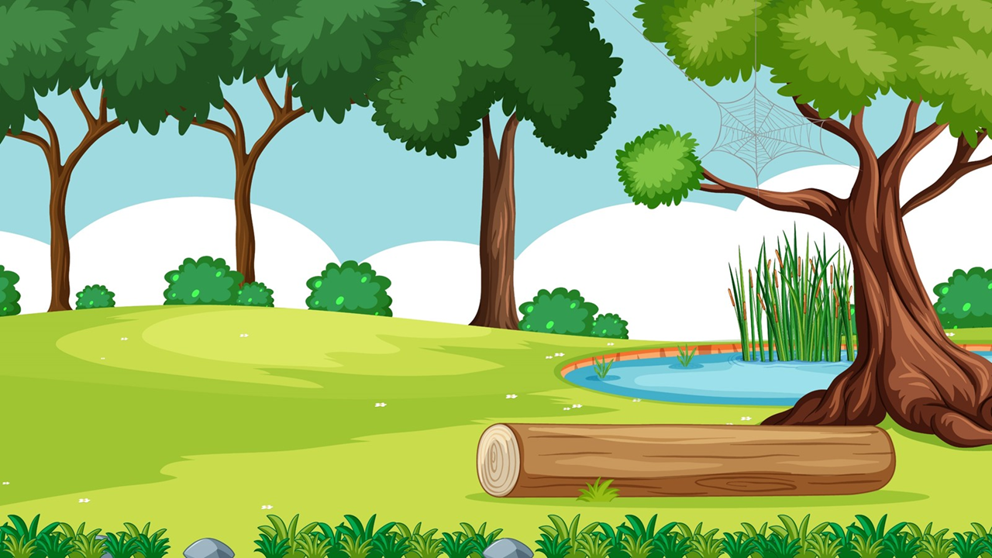
Start

Slide 12
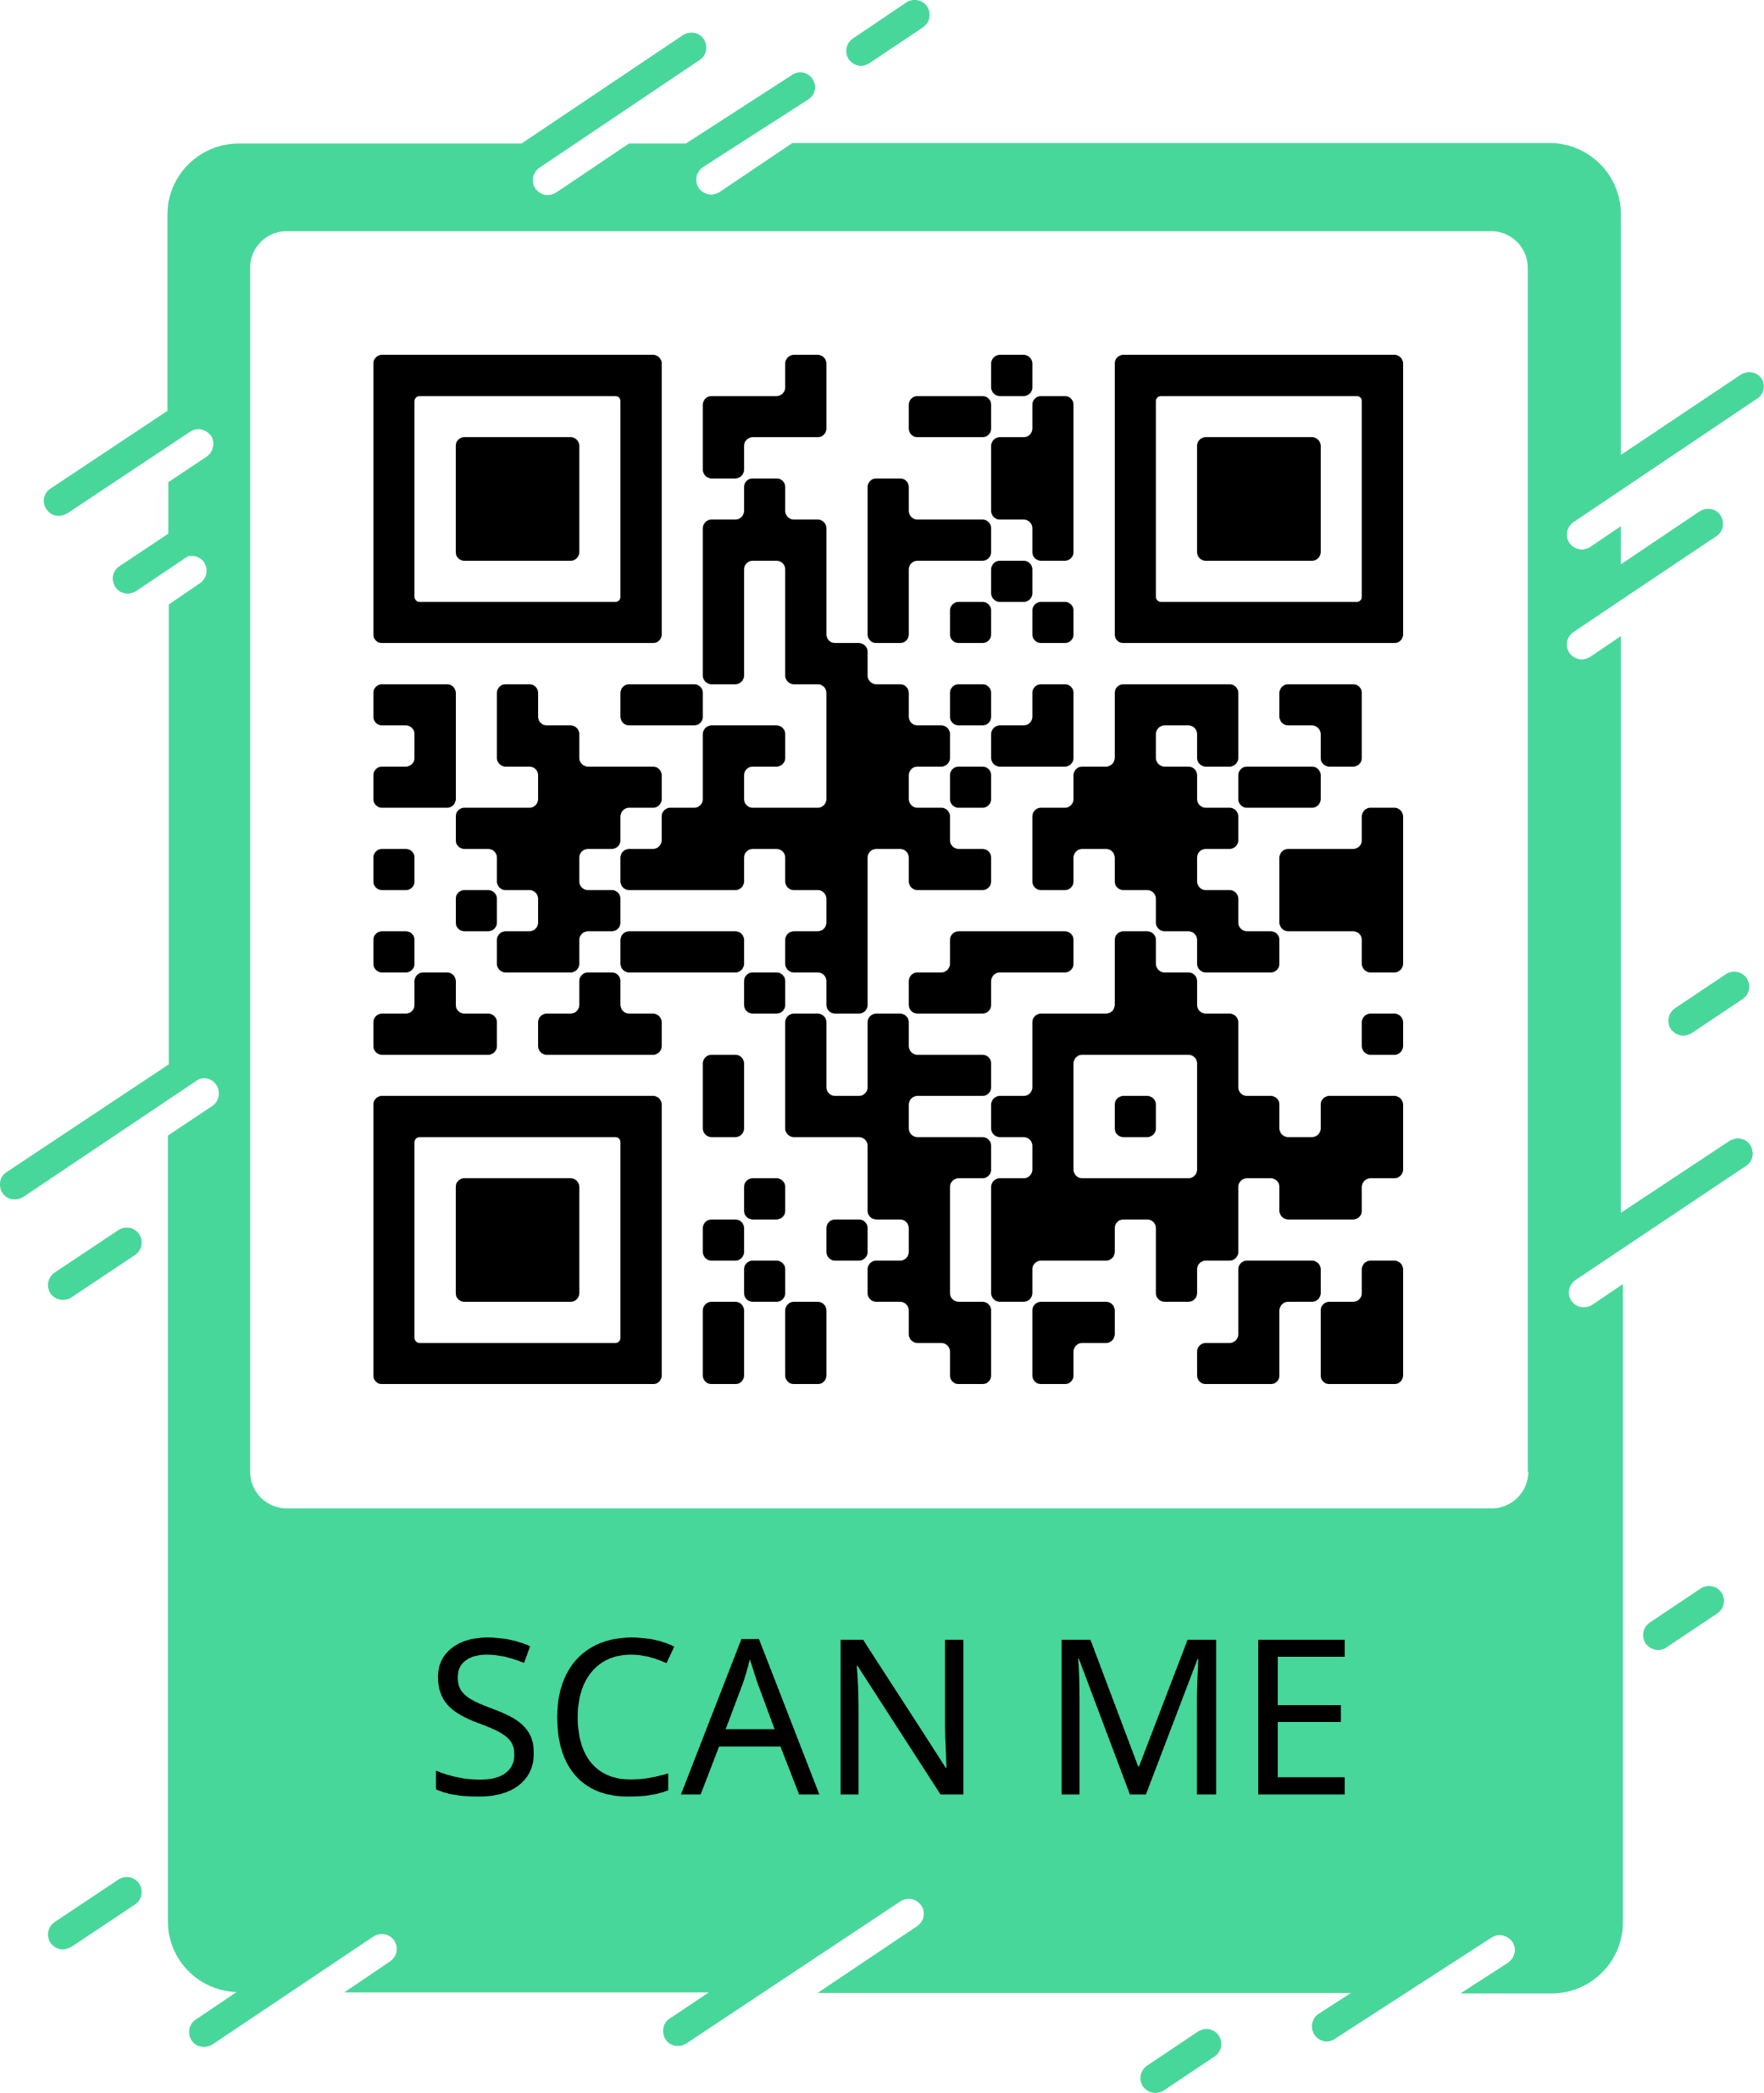
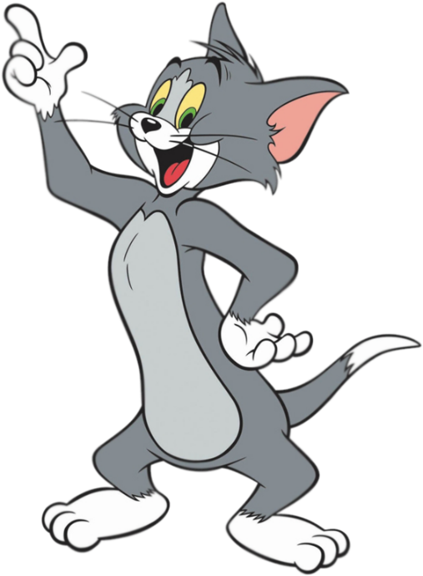
I have a school bag.
Next

Slide 13
I have a ruler .
Next

Slide 14
I have a book.
Next

Slide 15
I have a pen.
Next

Slide 16
I have a book.
Next

Slide 17
I have a ruler.
Next

Slide 18
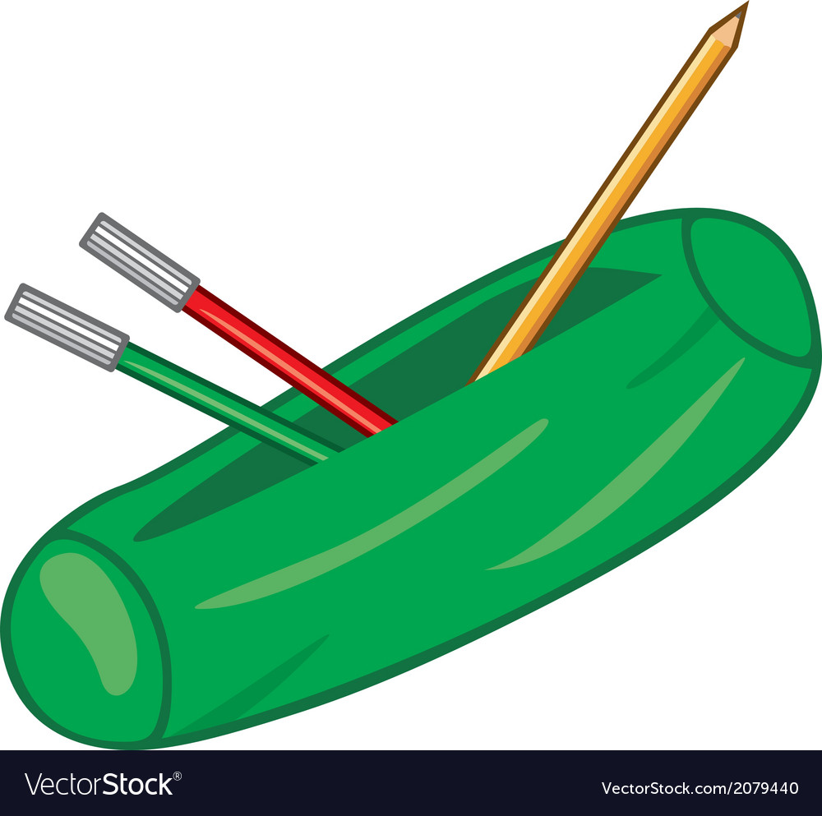
I have a school bag.
Next

Slide 19
I have a pen.
Next

Slide 20
To be continued…
End

Slide 21
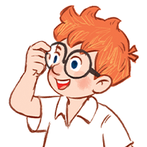
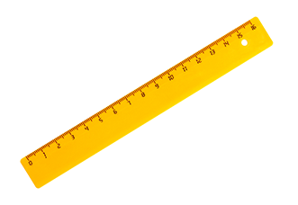
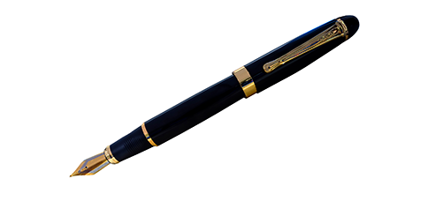
2
Listen, point and say.
I have _____.
a pen
a book
a ruler
a school bag

Slide 22
Structures
Cách nói mình có cái gì đó:
I have a/an _______?
(Tôi có một ________.)

Slide 23
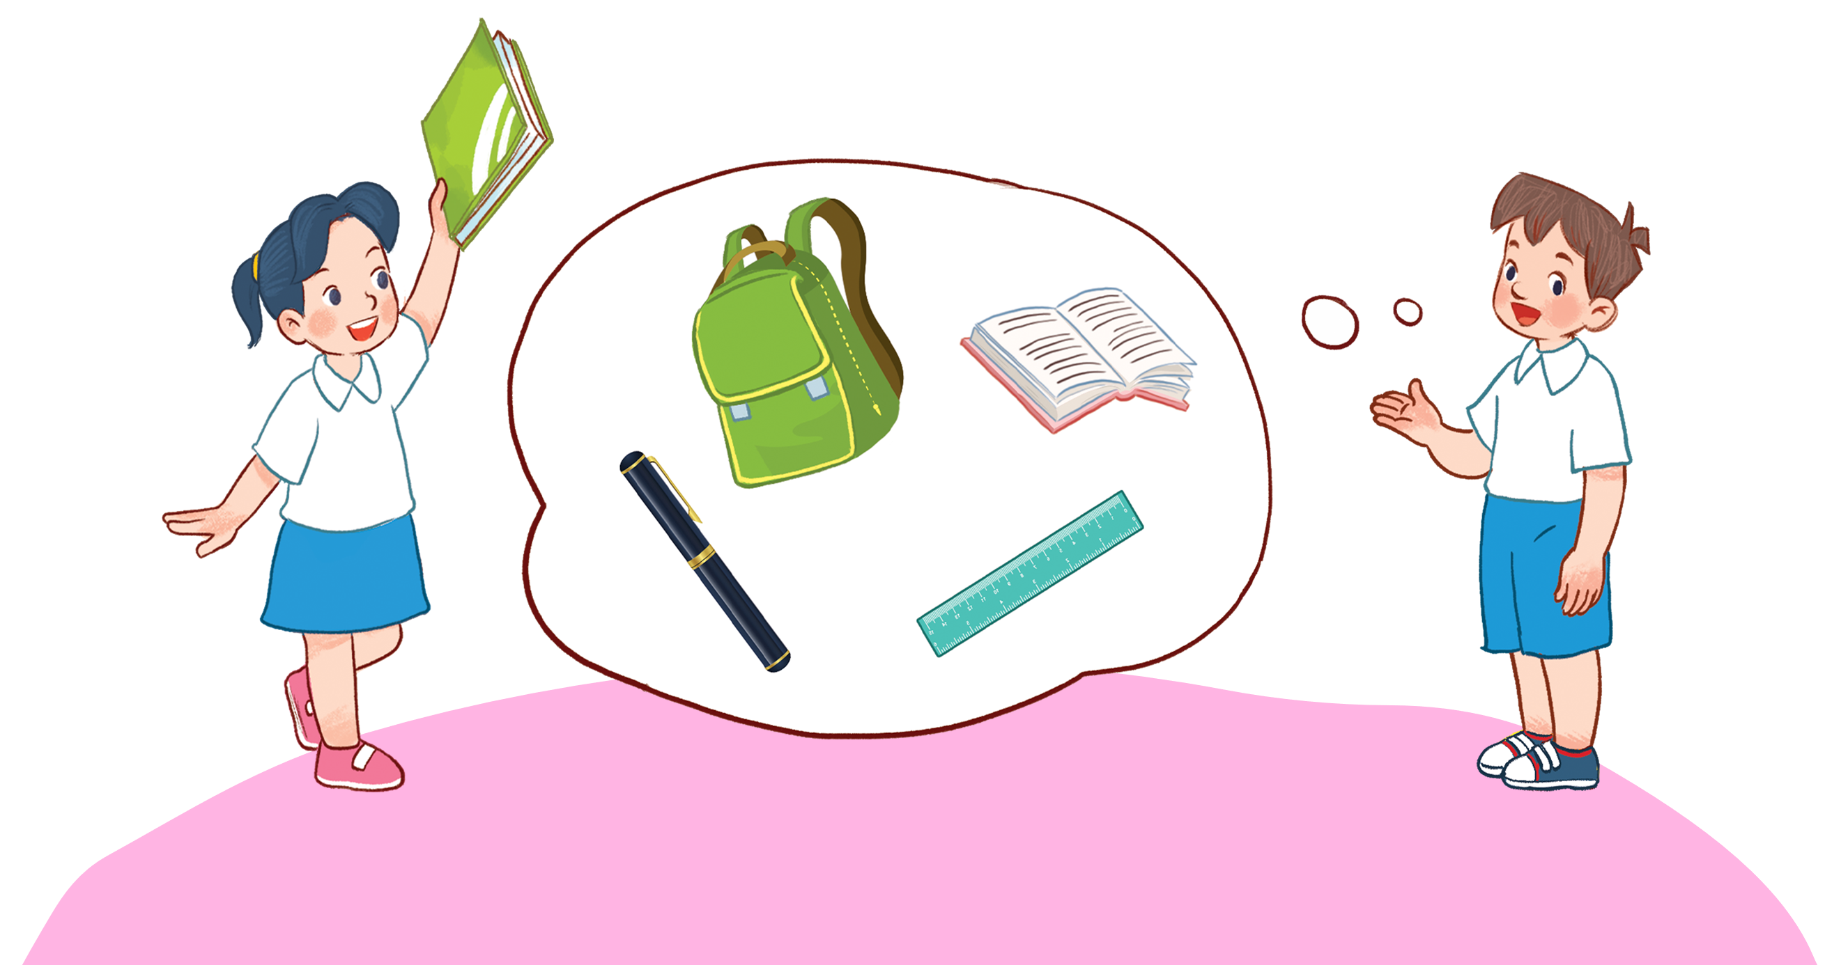
3
Let’s talk.

Slide 24
Thank you!

