Slide 1

Môn: Tiếng Anh
Tiết:62
Tuần dạy: 16
Tên bài dạy: Unit 10: Our summer holidays. Lesson 1 (1,2,3)
Ngày dạy: 24 / 12 / 2024.
Notes:
MADE BY FACEBOOK :TRAN THI THANH TAM

Slide 2
Nguyen Binh Khiem Primary School
WELCOME TO
OUR CLASS 4
Teacher: Nguyễn Thị Bích Vi
Notes:
MADE BY FACEBOOK :TRAN THI THANH TAM

Slide 3
UNIT 10:OUR SUMMER HOLIDAYS
LESSON 1 ( 1, 2, 3)
Notes:
MADE BY FACEBOOK :TRAN THI THANH TAM

Slide 4
Warm - up
Notes:
MADE BY FACEBOOK :TRAN THI THANH TAM

Slide 5
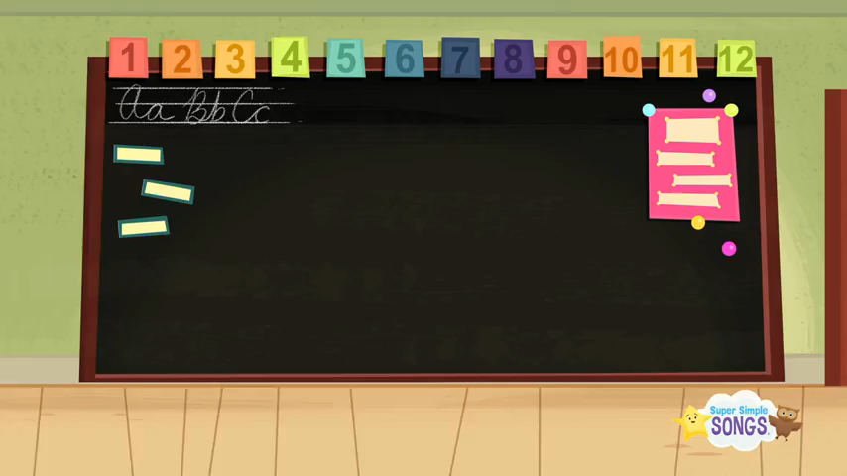
SING AND DANCE THE SONG: HELLO
Notes:
Made by FACEBOOK: TRAN THI THANH TAM

Slide 6

VOCABULARY
At the zoo: ở vườn sở thú
At the campsite:ở khu cắm trại
On the beach: ở bãi biển
In the countryside: ở miền quê

Slide 7
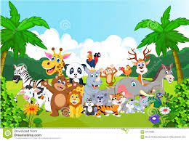

At the zoo: ở vườn sở thú
Notes:
MADE BY FACEBOOK :TRAN THI THANH TAM

Slide 8

On the beach: ở bãi biển
Notes:
MADE BY FACEBOOK :TRAN THI THANH TAM

Slide 9

At the campsite:
ở khu cắm trại
Notes:
MADE BY FACEBOOK :TRAN THI THANH TAM

Slide 10
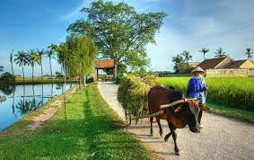
In the countryside:
ở nông thôn
Notes:
MADE BY FACEBOOK :TRAN THI THANH TAM

Slide 11
Let's play
MATCHING
Notes:
Made by Facebook: TRAN THI THANH TAM

Slide 12

Guessing
Guessing?
At the campsite
Notes:
MADE BY FACEBOOK :TRAN THI THANH TAM

Slide 13
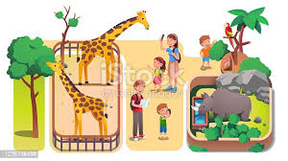
Guessing
Guessing?
At the zoo
Notes:
MADE BY FACEBOOK :TRAN THI THANH TAM

Slide 14
Guessing
Guessing?
On the beach
Notes:
MADE BY FACEBOOK :TRAN THI THANH TAM

Slide 15
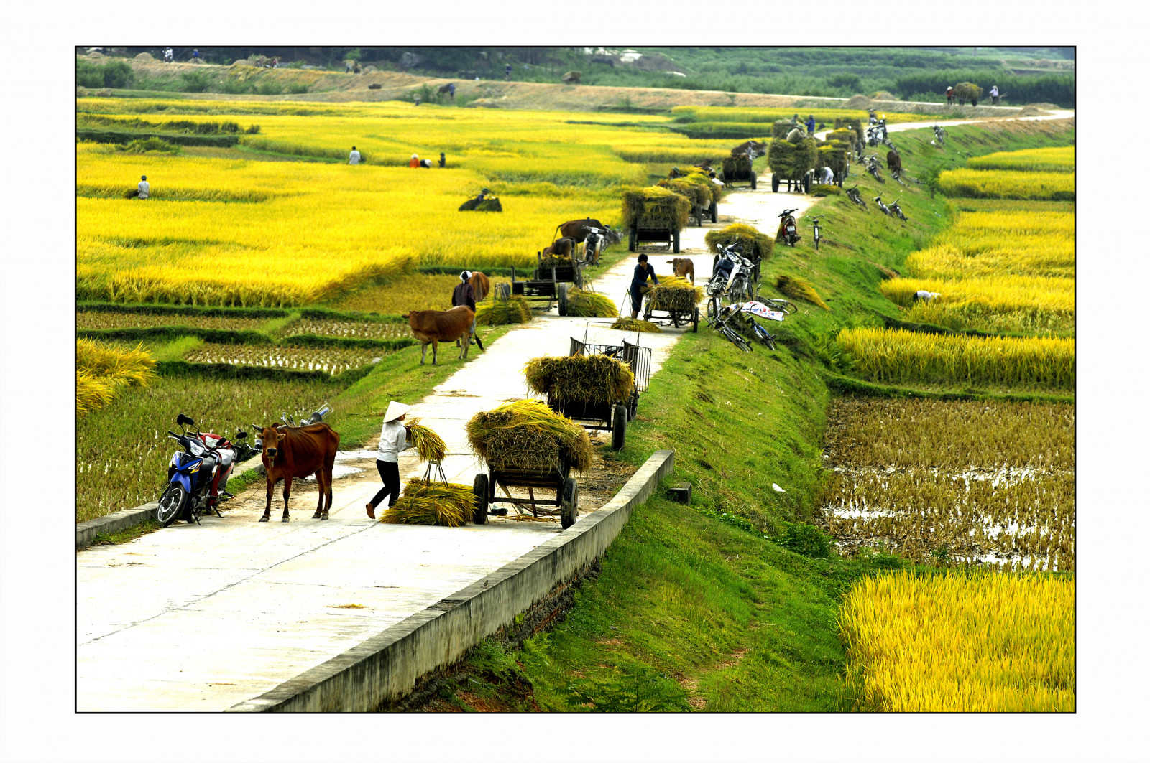
Guessing
Guessing?
In the countryside
Notes:
MADE BY FACEBOOK :TRAN THI THANH TAM

Slide 16
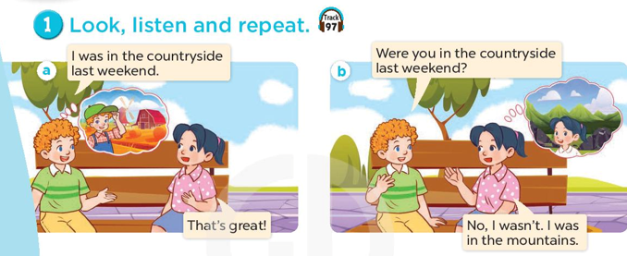
Notes:
MADE BY FACEBOOK :TRAN THI THANH TAM

Slide 17
SENTENCE PATTERN
Notes:
MADE BY FACEBOOK :TRAN THI THANH TAM

Slide 18
Hỏi xem có phải ai đó đã ở đâu cuối tuần trước
Were you at the zoo last weekend?
( có phải bạn ở vườn sở thú cuối tuần trước không vậy?)
Yes, I was. (Vâng phải)
No, I wasn’t. (Không phải)
Notes:
MADE BY FACEBOOK :TRAN THI THANH TAM

Slide 19
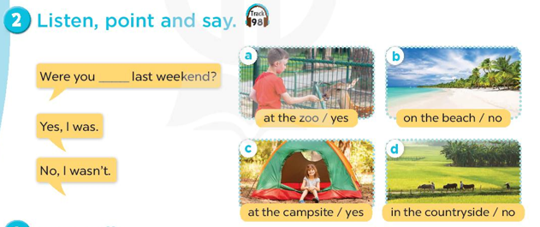
at the zoo
Notes:
MADE BY FACEBOOK :TRAN THI THANH TAM

Slide 20
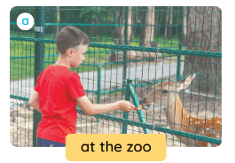
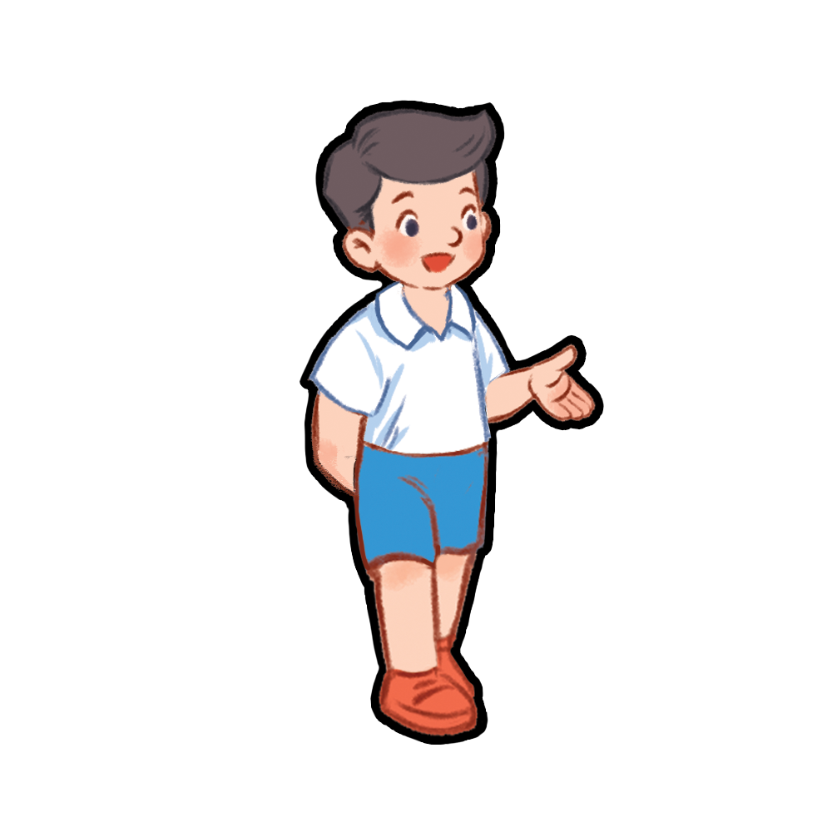
at the zoo
Were you …………………last weekend?
Yes, I was.
Notes:
MADE BY FACEBOOK :TRAN THI THANH TAM

Slide 21
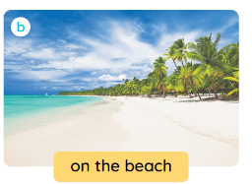
on the beach
Were you …………………last weekend?
No, I wasn’t.
Notes:
MADE BY FACEBOOK :TRAN THI THANH TAM

Slide 22

at the campsite
Were you….. …………………last weekend?
Yes, I was.
Notes:
MADE BY FACEBOOK :TRAN THI THANH TAM

Slide 23
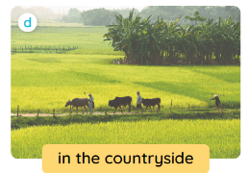
in the countryside
Were you…….… …………………last weekend?
No, I wasn’t.
Notes:
MADE BY FACEBOOK :TRAN THI THANH TAM

Slide 24
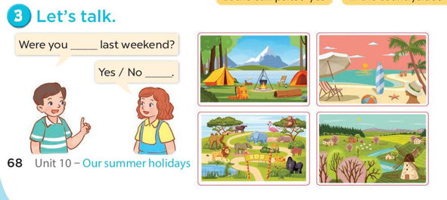
at the zoo
No, I wasn’t.
Yes, I was.
Notes:
MADE BY FACEBOOK :TRAN THI THANH TAM

Slide 25
SUMMARY
Notes:
MADE BY FACEBOOK :TRAN THI THANH TAM

Slide 26

SUMMARY
2. Sentence pattern:
-Were you at the zoo last weekend?
(Có phải bạn đã ở vườn sở thú cuối tuần trước không?)
-> Yes, I was.
-> No, I wasn’t.
1.Vocabulary:
At the zoo: ở vườn sở thú
At the campsite:ở khu cắm trại
On the beach: ở bãi biển
In the countryside: ở miền quê

Slide 27
Homework:
- Learn vocabulary by heart
- Prepare Unit 10 - lesson 1 ( 4, 5, 6)
Notes:
MADE BY FACEBOOK :TRAN THI THANH TAM

Slide 28
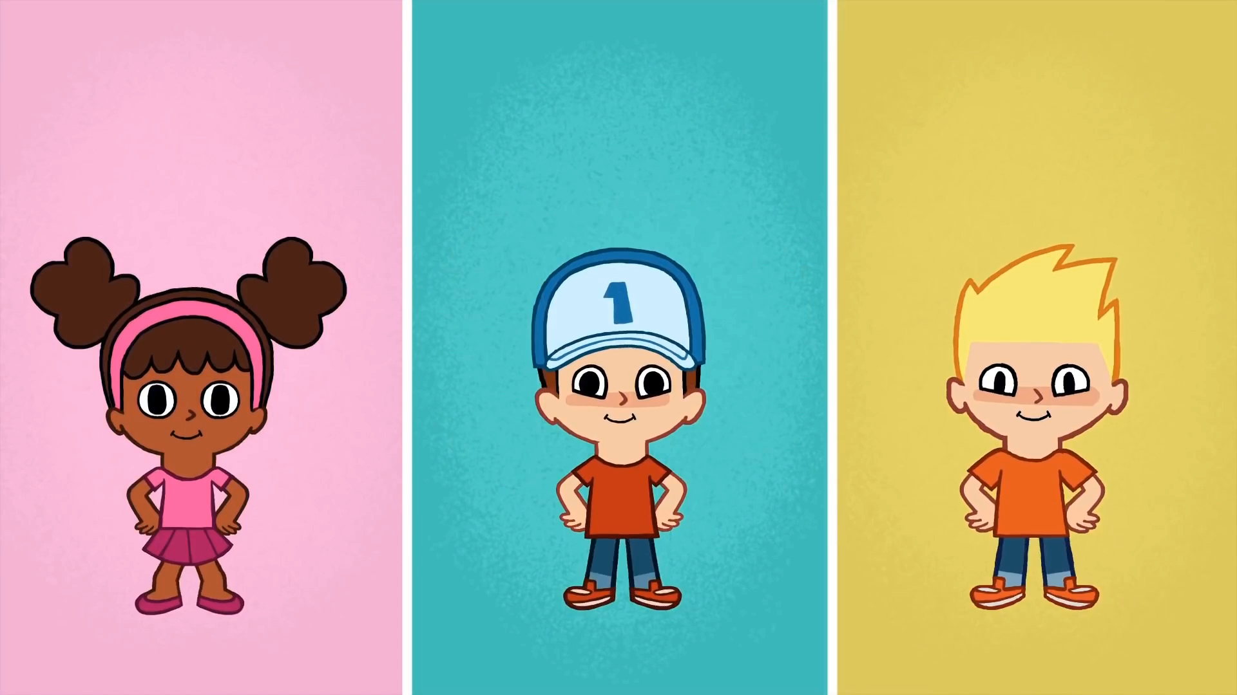
* SING AND DANCE: BYE BYE GOODBYE SONG

Slide 29



Thank you very much
Good bye! See you again!
Notes:
MADE BY FACEBOOK :TRAN THI THANH TAM

