Slide 1
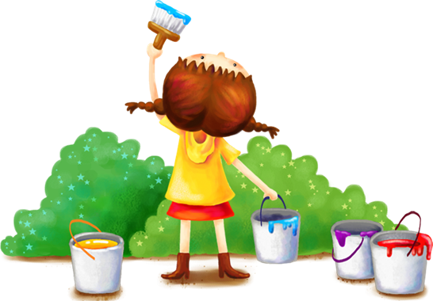
Unit 9
Colour
Lesson 2 - period 1
Ms. Van Trinh

Slide 2
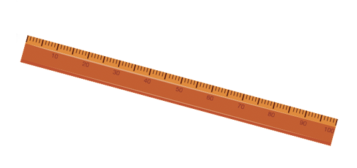
Review
What colour is it?
It’s ________.
blue
brown
red
yellow

Slide 3
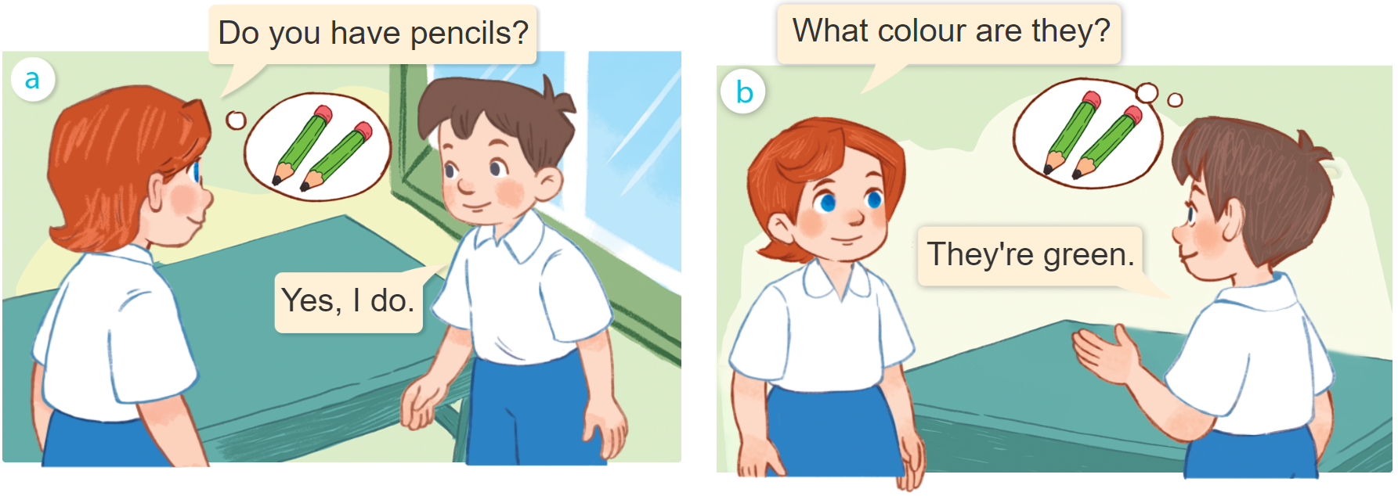
1
Look, listen and repeat.

Slide 4
Structures
Hỏi và trả lời về màu sắc (khi có từ 2 đồ vật trở lên):
What colour are they?
(Chúng màu gì?)
They’re ________.
(Chúng màu _____)

Slide 5
Vocabulary
orange
: Màu cam
/ˈɔːrɪndʒ/
green
: Màu xanh lá
/ɡriːn/
white
: Màu trắng
/waɪt/
black
: Màu đen
/blæk/

Slide 6
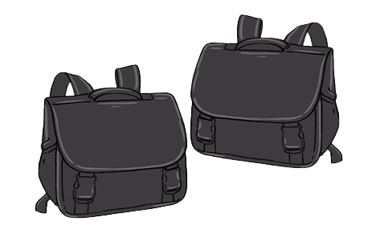
2
Listen, point and say.
What colour are they?
They’re ______.
orange
green
white
black

Slide 7
Play

Slide 8
Choose a quesstion
Choose a quesstion
Choose a quesstion
Choose a quesstion
Choose a quesstion
Choose a quesstion
End
-1
1
2
3
4
5
6
-5
Choose 1 box to open.
Beware of bombs or dynamites.
Green Gem +1pt
Purple Gem +5pts
Trophy +10 pts
Crying face -3 pts
-2

Slide 9
What colour are they?
They’re orange.

Slide 10
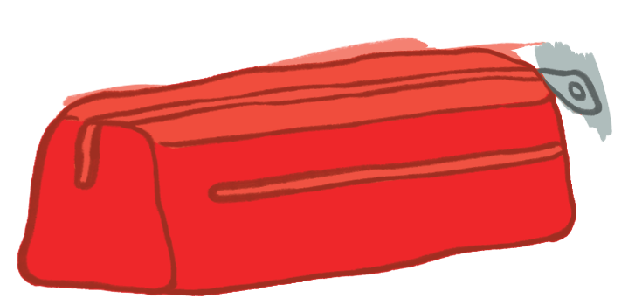
What colour are they?
They’re blue.

Slide 11
What colour are they?
They’re white.

Slide 12
What colour are they?
They’re green.

Slide 13
What colour are they?
They’re red.

Slide 14
What colour are they?
They’re brown.

Slide 15
3
Let‘s talk.
What color are they?
They’re ______.

Slide 16
Thank you!

